Slide 1
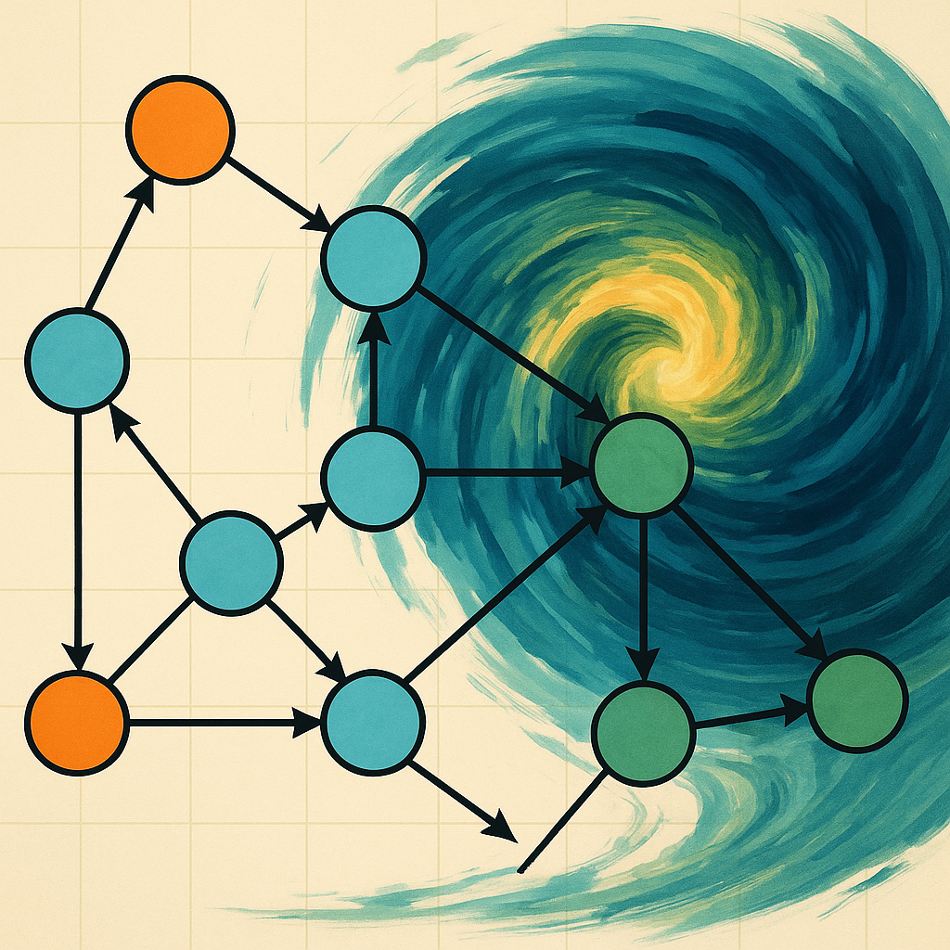
Reinforcement Learning
for Weather Forecasting
From neural networks to sequential decision‑making
STAT41130 – AI for Weather
5 August 2025

Slide 2

Outline
1. Motivation & recap of supervised methods
2. RL basics: MDPs, value functions & Q‑learning
3. Simple weather forecasting case study
4. Manual & library implementations
5. Comparisons, advantages & challenges
6. Applications, best practices & summary

Slide 3
Motivation & Recap
• While CNNs, RNNs and Transformers excel at predicting weather variables from past observations, they treat forecasting as a one‑off mapping from input to output. • Real‑world decisions (e.g. irrigation scheduling, energy load balancing) interact with forecasts over time. Reinforcement learning (RL) provides a framework for sequential decision‑making under uncertainty. • In RL an agent learns by trial and error to maximize cumulative rewards, making it a natural complement to probabilistic forecasting models.
Environment
state &
reward
action
Agent
[1]

Slide 4
Key components of RL
Environment: The world described by states and transition dynamics (e.g. atmospheric pressure regimes).
High
Agent: Learner/decision maker that observes states, takes actions (predicts weather) and receives rewards.
State: Summary of past information used to make decisions (e.g. “high” or “low” pressure).
0.3
Action: Choice made by the agent (e.g. predict sunshine or rain).
Low
Reward: Numerical feedback indicating quality of action (e.g. +1 for correct forecast, −1 otherwise).
0.4
Transitions
[1]

Slide 5
MDP & Value Functions
• A Markov Decision Process (MDP) consists of states S, actions A, a transition function P(s′|s,a) and a reward function R(s). • The value function U(s) measures the expected return when starting in state s and following the optimal policy. It satisfies the Bellman equation: U(s) = R(s) + γ max_a ∑_{s′} P(s′|s,a) U(s′) • The action‑value function Q(s,a) separates the choice of action from the state value. When using Q values we choose actions via π(s) = argmax_a Q(s,a).
Function | Definition
U(s) | Expected return starting at s under optimal policy
Q(s,a) | Expected return starting at s taking action a then optimal thereafter
[1] [2]

Slide 6
Q‑Learning: Update Rule
• Initialize Q(s,a) arbitrarily and repeat for each step: • Observe current state s and select an action a (ε‑greedy). • Receive reward r and next state s′; set Q(s,a) ← Q(s,a) + α [ r + γ max_{a′} Q(s′,a′) − Q(s,a) ]. • Update s ← s′ and continue. The learning rate α ∈ (0,1) controls the step size; γ ∈ (0,1) discounts future rewards.
Q(s,a) ← Q(s,a) + α [ r + γ max_{a′} Q(s′,a′) − Q(s,a) ]
[1]

Slide 7
Q‑Learning Pseudocode
Initialize Q(s,a) = 0 for all states s and actions a
for each episode:
choose initial state s
repeat until termination:
choose action a using ε‑greedy policy
take action a, observe reward r and next state s′
Q(s,a) ← Q(s,a) + α [ r + γ max_{a′} Q(s′,a′) − Q(s,a) ]
set s ← s′
[1]

Slide 8
Case Study: Weather RL Example
• States: two pressure regimes – s=0: High pressure (tends to be sunny). – s=1: Low pressure (tends to be rainy). • Actions: predict Sunshine (a=0) or Rain (a=1). • Transition probabilities:
State | Pr(Next=High) | Pr(Next=Low)
High | 0.7 | 0.3
Low | 0.4 | 0.6
Reward: +1 if action equals next state, −1 otherwise.
[1]

Slide 9
Learned Q‑Table & Policy
State | Predict Sun | Predict Rain | Best Action
High | 1.81 | 0.50 | Sun
Low | 0.77 | 0.24 | Sun
The learned Q‑table suggests predicting sunshine in both high and low pressure regimes because the transition probabilities favour returning to high pressure. Policy π(s): select the action with the highest Q value in each state.
[1]

Slide 10
Training Progress
Learning gradually improves the agent’s average reward towards positive values.
[1]

Slide 11
Manual Q‑Learning Implementation
import numpy as np
# Parameters
alpha, gamma, epsilon = 0.5, 0.9, 0.2
n_states, n_actions = 2, 2
Q = np.zeros((n_states, n_actions))
for episode in range(50):
s = np.random.choice(n_states)
for step in range(10):
# ε‑greedy action selection
if np.random.rand() < epsilon:
a = np.random.choice(n_actions)
else:
a = np.argmax(Q[s])
# sample next state and reward
s_next = np.random.choice(n_states, p=[0.7, 0.3] if s==0 else [0.4, 0.6])
r = 1 if a == s_next else -1
# Q‑update
Q[s,a] += alpha*(r + gamma*np.max(Q[s_next]) - Q[s,a])
s = s_next
• Reward uses correct vs incorrect prediction to drive learning. • Discount factor γ emphasises future rewards; learning rate α controls update speed.
[1]

Slide 12
Designing an RL Environment for Forecasting
• State representation should summarise recent meteorological observations (e.g. pressure regime, temperature anomaly). • Actions may represent forecasting decisions: choose a model, choose prediction horizon or adjust a correction factor. • Reward signals must be carefully designed; they often involve proper scoring rules (Brier, log, CRPS) to encourage calibration and sharpness.
State features
Select model
Reward
[1]

Slide 13
Using RL Libraries (e.g. Stable‑Baselines3)
from stable_baselines3 import DQN
from custom_env import WeatherEnv
# Create environment where states, actions, rewards defined as above
env = WeatherEnv()
# Initialize Deep Q Network (DQN)
model = DQN(
"MlpPolicy", env, verbose=1,
learning_rate=1e-3, gamma=0.95, exploration_fraction=0.2
)
# Train the agent
model.learn(total_timesteps=10000)
# Evaluate or deploy
obs = env.reset()
action, _ = model.predict(obs, deterministic=True)
• Stable‑Baselines3 supplies ready‑made RL algorithms (DQN, A2C, PPO) that can approximate Q values using neural networks. • Custom environments should inherit from gym.Env and implement reset() and step() to return observations, rewards and done flags.
[1]

Slide 14
Evaluation & Scoring
• Rewards in our RL environment can be derived from proper scoring rules used in probabilistic forecasting. For example: Brier score: measures squared error between predicted probability and truth (minimise for calibration). Logarithmic score: penalises inaccurate probabilistic predictions via −log p(y). CRPS: integrates squared differences between forecast CDF and empirical step function.
Rule | Reward = –score
Brier | –(p − y)^2
Log | – log p(y)
CRPS | –∫ (F_D(z) − 1(z≥y))^2 dz
[1]

Slide 15
RL vs Supervised Forecasting
Aspect | Supervised ML | Reinforcement Learning
Objective | Minimise prediction error via loss function | Maximise cumulative reward based on actions
Feedback | One‑off comparison to ground truth | Sequential interaction; reward depends on outcome and policy
Suitable for weather forecasting? | Yes – standard approach (LSTM, CNN, Transformer) | Limited – environment is passive; predictions do not change weather
Use cases | Predict temperatures, rainfall, humidity from observations | Select models, adjust forecast horizon, schedule actions
RL excels when actions influence the environment; for pure forecasting tasks the environment remains unaffected so RL offers little benefit over supervised learning.
[1]

Slide 16
RL for Model Combination
• Suppose we have two forecasting models (CNN & LSTM). RL agent chooses which model to use at each time step based on recent state. • Reward is the negative error (e.g. −CRPS) of the chosen model’s prediction. • Agent learns to pick the model that performs better under current conditions.
CNN
Reward
State features
LSTM
[1]

Slide 17
Model Selection Results
RL can learn to pick the best model given current conditions, yielding lower CRPS than fixed or random selection.
[1]

Slide 18
Hyperparameters in RL
• Learning rate (α): step size for Q‑update; too high causes instability, too low slows learning. • Discount factor (γ): weighting of future rewards; higher values encourage long‑term planning. • Exploration rate (ε): probability of random actions; decays over time to exploit learned policy. • Neural network parameters (when using DQN): hidden units, layers, optimizer, batch size.
[1]

Slide 19
Variants & Extensions
• SARSA: on‑policy TD method; updates using Q(s′,a′) from the next action executed. • Deep Q Networks (DQN): uses neural networks to approximate Q values; includes experience replay and target networks. • Policy gradient & actor–critic: learn a policy π_θ(a|s) directly and a value function V_ϕ(s); stable training with baseline.
Q(s,a)
s
[1]

Slide 20
Applications Beyond Forecasting
• Irrigation & water resource management: RL determines optimal irrigation schedule using forecast and soil moisture states. • Energy load balancing: RL optimises heating/cooling based on predicted temperatures and energy prices. • Disaster preparedness: RL helps decide when to issue warnings and allocate resources based on evolving forecasts.
[1]

Slide 21
Limitations & Challenges
• Passive environment: forecasts do not affect future weather, so RL may not produce significant gains over supervised models. • Reward design is non‑trivial: inappropriate reward functions can lead to pathological behaviour or poor calibration. • Sample inefficiency: RL typically requires many interactions, whereas meteorological data are costly. • Explainability: RL policies can be opaque when using deep neural networks.
[1]

Slide 22
Best Practices & Tips
• Start with simple environments and discrete actions before moving to high‑dimensional spaces. • Normalise inputs and reward scales to stabilise learning. • Use ε‑greedy or softmax exploration and anneal ε gradually. • Monitor performance using proper scoring rules and calibration diagnostics (reliability diagrams, PIT histograms). • Evaluate RL against strong supervised baselines to justify its added complexity.
[1]

Slide 23
Case Study Summary
• The RL agent operates in a two‑state Markov model. Rewards are +1 for correct prediction and −1 for incorrect. • After training, Q values favour “predict sun” in both states because high pressure tends to persist and low pressure often transitions back to high. • The average reward improves over episodes, illustrating the learning process. • However, because predictions do not alter weather, the RL policy reduces to selecting the most likely outcome, similar to a supervised classification model.
[1] [2]

Slide 24
Real‑World RL in Climate & Weather
• RAIN project: RL for parameterising sub‑grid processes in climate models (e.g. convection). • RL for dynamic model combination in meteorology: selects among different numerical models to minimise forecast error. • RL for resource allocation: controlling irrigation or energy systems based on forecasts and system dynamics.
RL in climate
[1]

Slide 25
Conclusion & Summary
• RL provides a powerful framework for sequential decision‑making but is rarely necessary for pure weather forecasting because predictions do not influence the weather. • A simple case study demonstrated how an agent learns a policy via Q‑learning in a two‑state environment; the learned policy mirrors the most likely outcome. • RL can be valuable for model selection, resource management and other tasks where actions change subsequent states. • Combining supervised models with RL can yield adaptive systems when forecasts drive decisions.
[1] [2]

Slide 26
Further Reading
• Sutton, R.S. & Barto, A.G. (2018). Reinforcement Learning: An Introduction – definitive RL textbook. • CS440/ECE448 Lecture 31: Markov Decision Problems (University of Illinois) – accessible notes on Q‑learning and Bellman equations. • Data Science Stack Exchange discussion: Can RL be applied to time series forecasting? – explains why RL is seldom beneficial for forecasting alone. • Research papers on RL in climate science (e.g. RAIN project) for advanced applications.
[1] [2]

Slide 27
Discussion & Questions
What potential applications of reinforcement learning can you envision in meteorology and climate services?
How might we design rewards that encourage calibrated forecasts and useful actions?
[1]

Slide 28
Exploration Strategies
ε‑greedy: select a random action with probability ε, otherwise choose the action with the highest Q value. This simple strategy injects exploration into deterministic policies. Decaying ε: start with large ε to explore; gradually reduce ε as learning progresses to exploit learned policy. Softmax/entropy: sample actions according to a Boltzmann distribution based on Q values or use an entropy term in the loss to encourage diverse choices.
Epsilon decay over episodes
[1]

Slide 29
Step‑by‑Step Q‑learning Update
Consider a single transition in our two‑state case study: State s₀ = high pressure, action a = predict rain, reward r = +1, next state s′ = low pressure. Update rule: Q(s,a) ← Q(s,a) + α [ r + γ max_{a′} Q(s′,a′) − Q(s,a) ].
Parameter | Value
Initial Q(s₀,a) | 0.00
Reward r | 1
maxₐ Q(s′,a) | 0.00
α (learning rate) | 0.1
γ (discount) | 0.9
Update | 0 + 0.1 × (1 + 0.9 × 0 − 0) = 0.10
After one update Q(s₀,a) = 0.10. Repeated updates converge to the Q values seen in the case study.
[1]

Slide 30
Actor–Critic & Entropy Regularization
Actor–critic methods learn separate networks: an "actor" mapping states to action probabilities and a "critic" estimating value functions. Entropy bonus: to encourage exploration, modern algorithms (e.g. PPO) add an entropy term to the reward or loss. High entropy early in training promotes diverse actions; as learning progresses, entropy decays and the policy becomes more deterministic. Loss function example: L = −E_t [hat{R}_t cdot log pi_θ(a_t|s_t) + β · H(pi_θ(·|s_t))] where H(π) is the policy entropy and β controls exploration.
Critic
Value
Actor
Policy
[1]

